Slide 1

AVOIDDY

Slide 2

Problem
- Waste of time and resources caused by misinformation of employees.
- Same/repetitive questions
Similar/repetitive answers
- According to [1]Sameer Bhatia the average employee spends 40% of his or her time looking for information.

Slide 3




Solution
Facilitate the communication between departments in the company, by the automatization of responses to frequent questions.
Creating a “smart” chatbot which is able to give immediate responses to employees. Otherwise, It’ll call the person in charge.

Slide 4
Future Work
Execute actions/processes.
Using Machine learning/NLP to identify intent of the messages, extract entities and provide an immediate response.
Make it scalable, not just for local companies.
Have special permissions (authorized people who can do certain procedures).

Slide 5
References
[1]. ”Top five advantages of using FAQ software”, [Accessed 06/03/2018] Available from> http://smallbizclub.com/technology/software/top-5-advantages-of-using-faq-software/ Author: Sameer Bhatia is founder & CEO of ProProfs.com

Slide 6
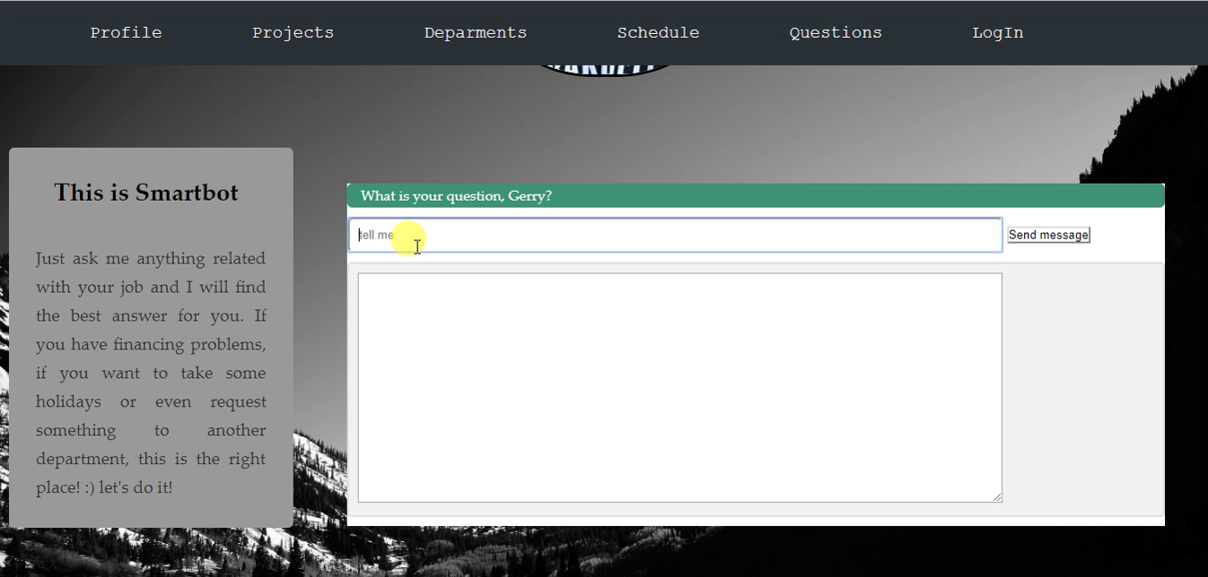
Demo

